Slide 1

MCA Major Project Mid Term Evaluation
Lightweight key Exchange For secure Drone Communication
Under the guidance of
Faculty Guide Name:-Dr.Pragya Vaishnav
Department of Computer Applications
Faculty of Science, Technology and Architecture
Manipal University Jaipur
By
Hrisikesh Roy
23FS20MCA00049
2023-25

Slide 2
Outline
Introduction
Motivation
Process Model
Software Requirement Specification (SRS)
Data Flow Diagram (DFD)
Output
Conclusion
Future Scope

Slide 3

Introduction
Unmanned aerial vehicles (UAVs), commonly known as drones, have become integral to various applications, including surveillance, agriculture, healthcare, and military operations. These systems rely heavily on secure and efficient communication to ensure mission success. However, drone communication faces unique challenges due to limited computational resources, susceptibility to cyber threats, and the need for real-time data exchange
Lightweight key exchange mechanisms are designed to address these challenges by enabling secure communication with minimal computational overhead. Unlike traditional cryptographic methods, lightweight protocols are optimized for devices with constrained resources, making them ideal for drones. These mechanisms play a crucial role in protecting sensitive data and ensuring the reliability of drone networks in diverse environments

Slide 4
Motivation
With the increasing use of drones in surveillance, delivery, and military applications, secure communication is a major challenge. Traditional encryption methods, such as RSA and AES, offer strong security but require high computational power and energy, making them unsuitable for resource-constrained drones.
Key Motivations for Lightweight Key Exchange:
Real-time Communication: Secure data exchange must be fast and efficient for real-time control and decision-making
Susceptibility to Attacks: Drones are vulnerable to hacking, spoofing, and interception, requiring strong yet efficient encryption methods.
A lightweight key exchange mechanism ensures secure, energy-efficient communication, making drones safer and more reliable in real-world applications.

Slide 5
Process Model
The Lightweight Key Exchange Process Model ensures secure communication between the Ground Control Station (GCS) and the Drone while optimizing computational efficiency
1. Communication Initialization
The Ground Control Station (GCS) sends a connection request to the drone.
The drone acknowledges the request and prepares for a secure key exchange.
2. Lightweight Key Exchange
A lightweight cryptographic algorithm Lightweight RSA&NTRU is used.
Both the drone and GCS generate public and private key pairs.
The public keys are exchanged securely, and a shared secret key is derived.
3. Secure Communication Establishment
Using the shared secret key, an encrypted communication channel is created.
The drone and GCS encrypt and decrypt messages using a lightweight encryption algorithm.

Slide 6
Process Model
4. Secure Data Transmission
The drone transmits telemetry data, video feeds, and mission updates securely.
The GCS sends commands and navigation instructions, ensuring confidentiality and integrity.
5. Mission Completion & Secure Disconnection
Once the mission ends, the secure session is terminated.
The keys are discarded to prevent unauthorized access in future sessions

Slide 7
Software Requirement Specification (SRS)
Programming Language:- : Python
Libraries: DroneKit, PyCryptodome, RSA/NTRU Libraries
Hardware: Raspberry Pi with Pixhawk & Telemetry module
Communication Protocol: MAVLink, Secure UDP/TCP

Slide 8
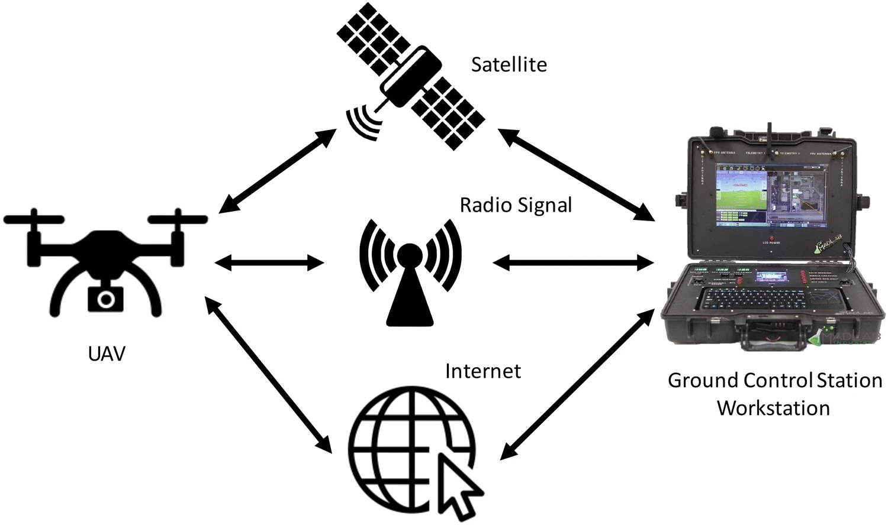
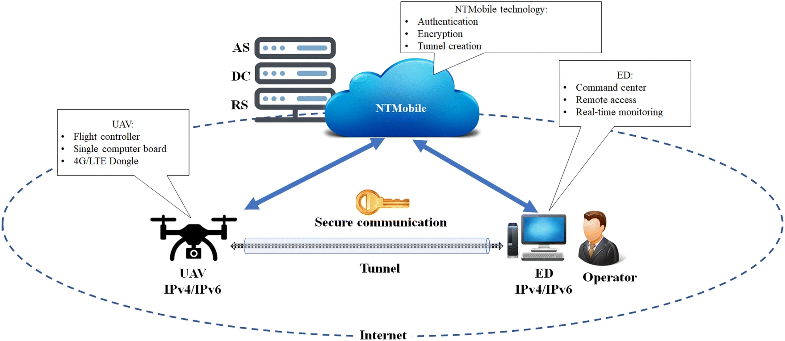
DFD
Fig:- 1
Fig:-2

Slide 9
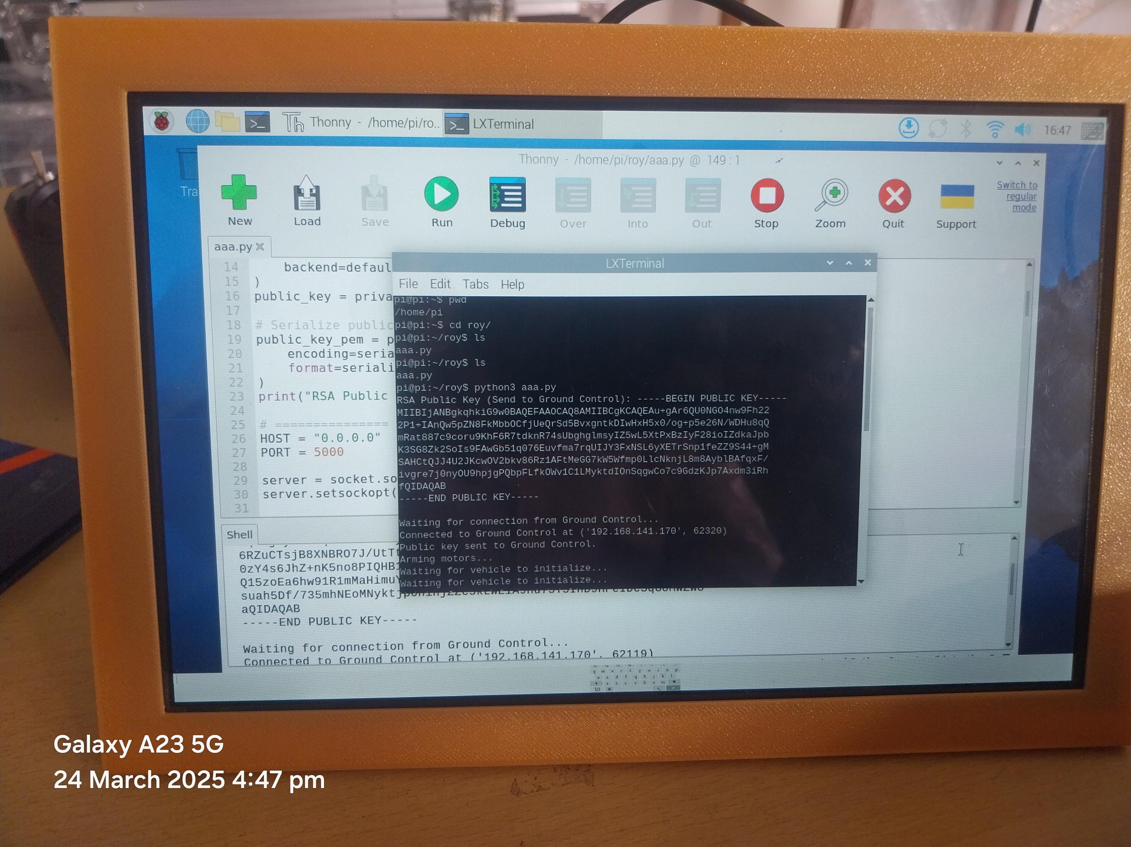
OUTPUT
Fig:-3

Slide 10
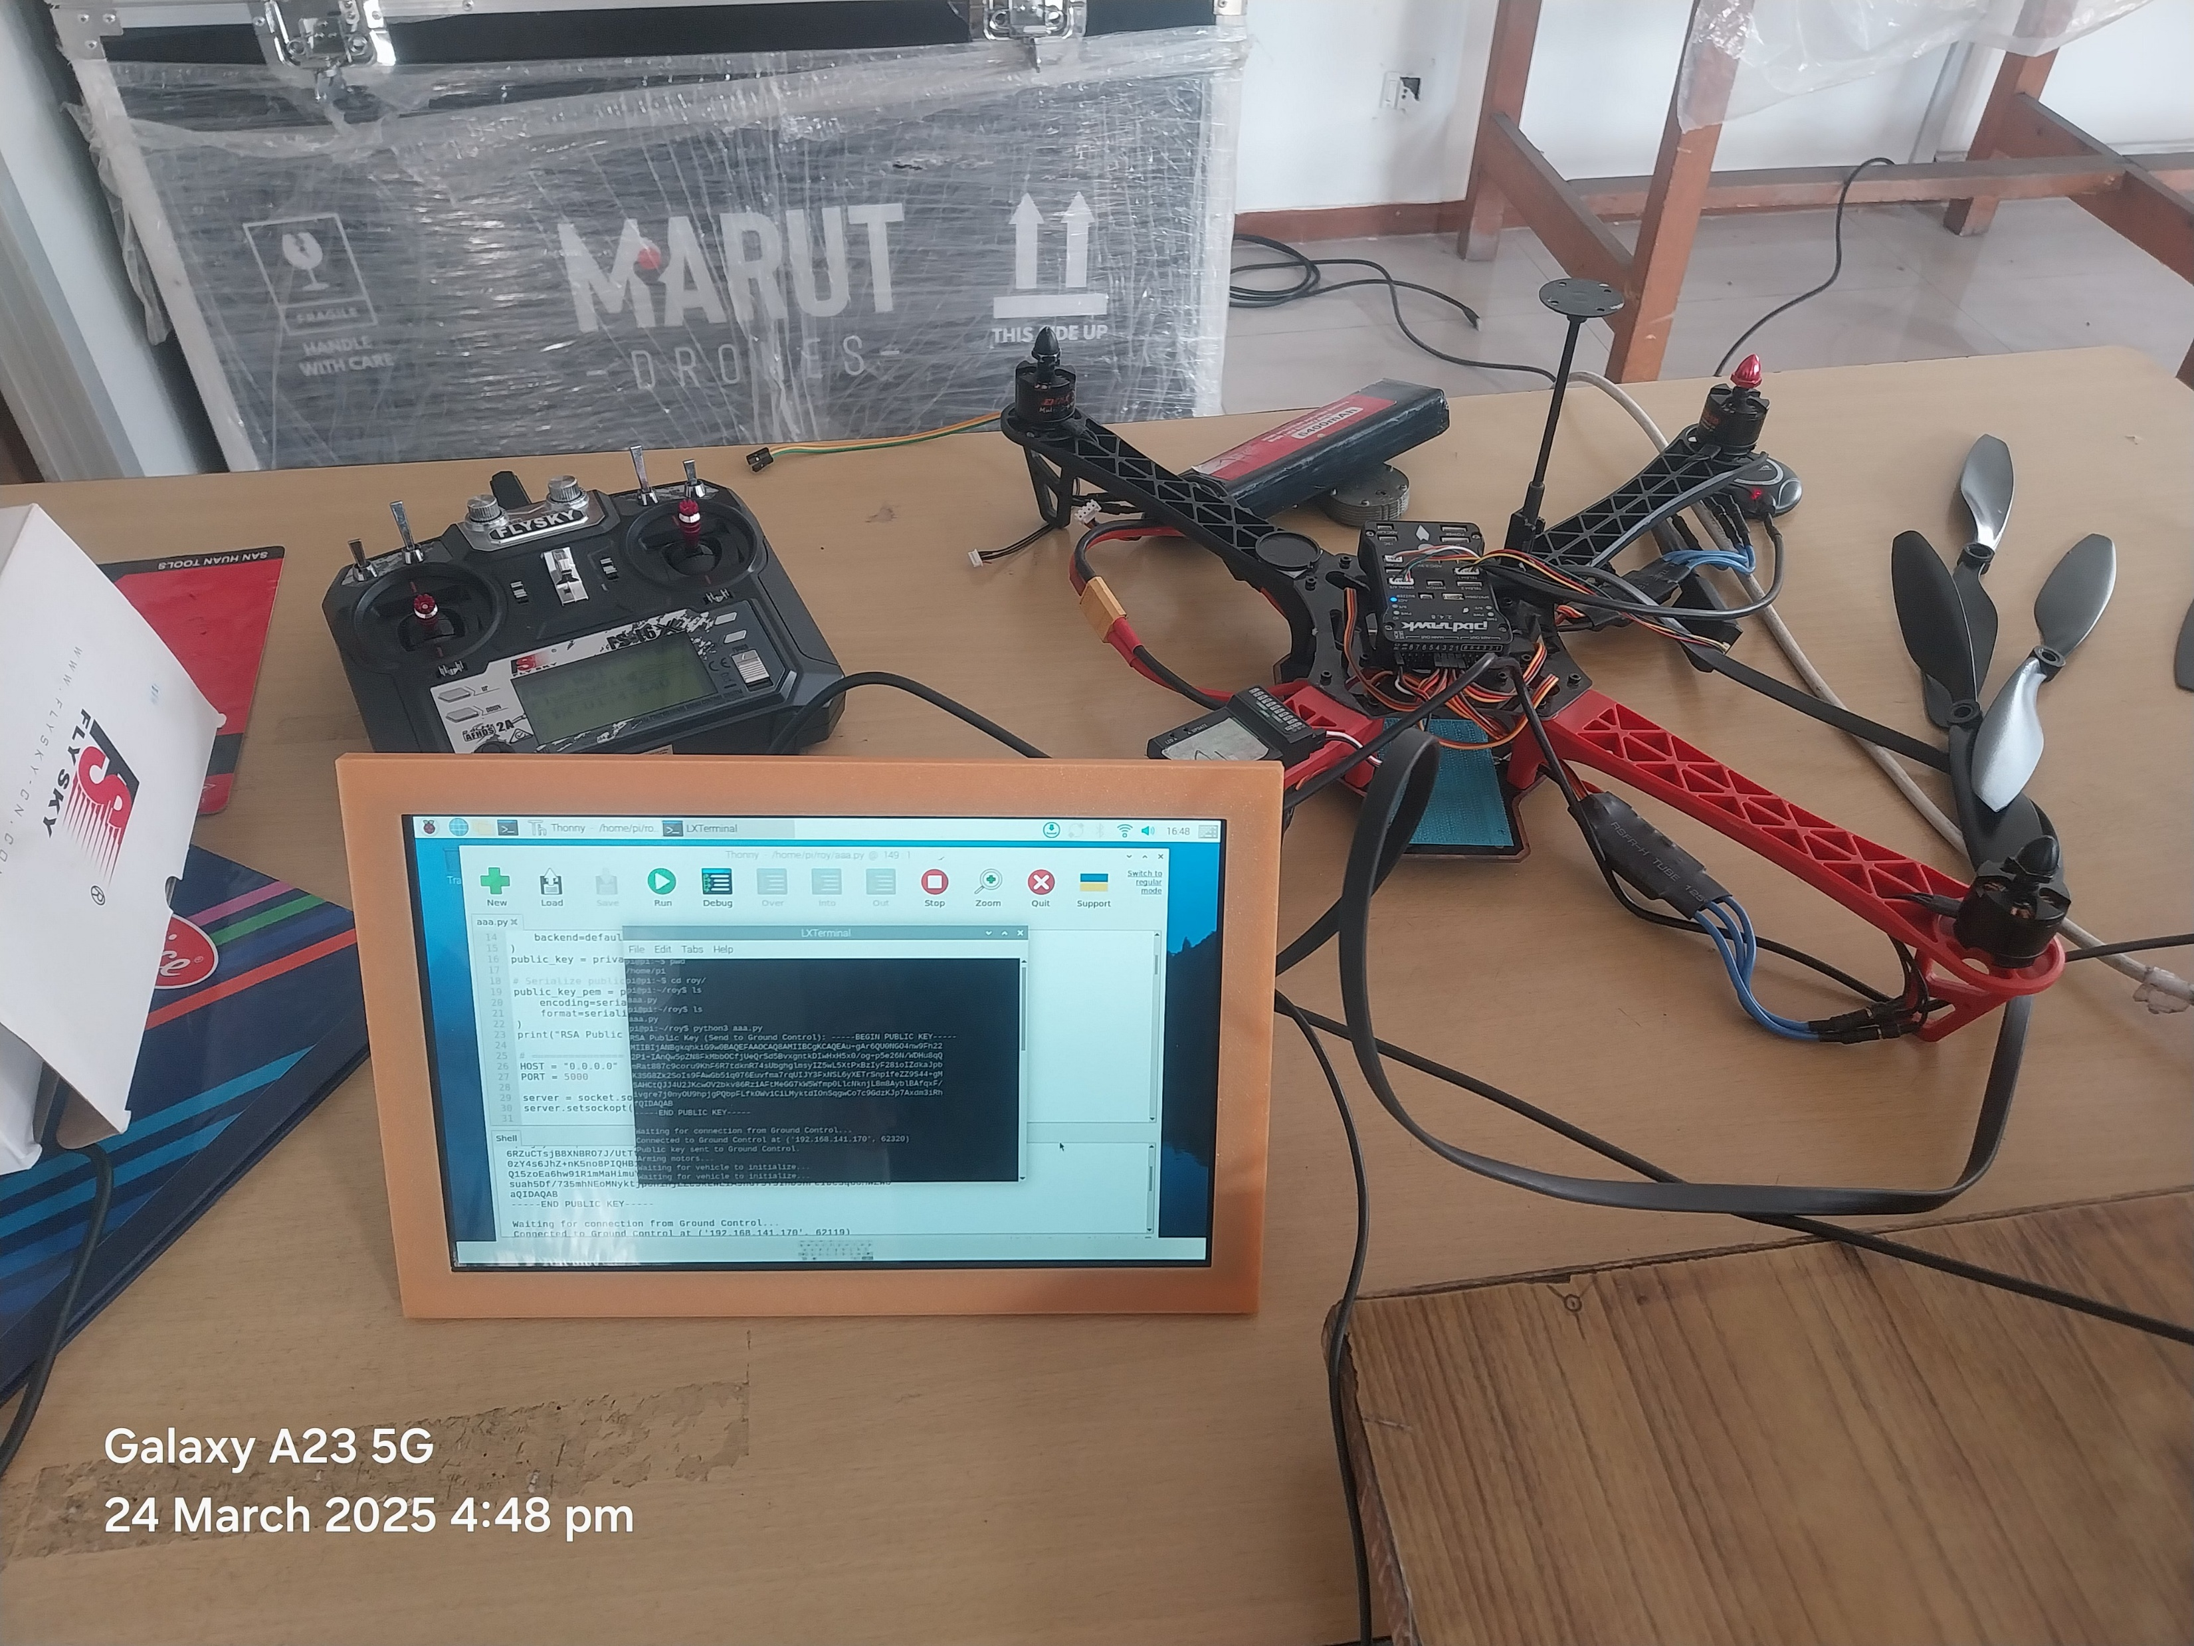
OUTPUT
Fig :4

Slide 11
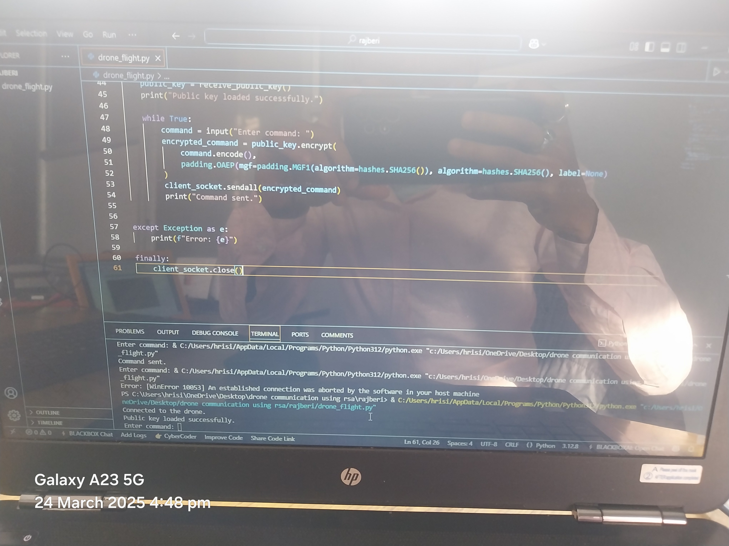
output
Fig :-5

Slide 12
Conclusion
In conclusion, the implementation of lightweight key exchange mechanisms for secure drone communication is essential in addressing the unique challenges posed by the operational constraints and security vulnerabilities of unmanned aerial vehicles (UAVs).
Enhanced Security:
Lightweight key exchange protocols, like ECDHE (Elliptic Curve Diffie-Hellman), provide a secure method to establish a shared secret between drones and ground stations.
These protocols ensure that the communication between the drone and the controller is protected from eavesdropping, man-in-the-middle attacks, and unauthorized access.
Real-time Communication:
With minimal processing requirements, the key exchange allows for rapid, secure communication, crucial for time-sensitive drone operations like deliveries, surveillance, and emergency responses.

Slide 13
Future Scope
The future of lightweight key exchange mechanisms for secure drone communication is promising, with several avenues for research and development aimed at enhancing security, efficiency, and scalability in UAV operations. The following points outline key areas for future exploration
Integration of Post-Quantum Cryptography:
With the advent of quantum computing, traditional cryptographic methods may become vulnerable. Incorporating post-quantum cryptographic techniques into lightweight key exchange protocols will be crucial to ensure long-term security against emerging threats. This research direction aims to create resilient systems that can withstand the capabilities of quantum attacks
Enhanced Security Protocols: Continuing to refine and enhance existing protocols, such as those utilizing Elliptic Curve Cryptography (ECC) and Advanced Encryption Standard with Galois/Counter Mode (AES-GCM), will be vital. Research could focus on optimizing these protocols further to minimize computational costs while maintaining high security standards.

